Slide 2
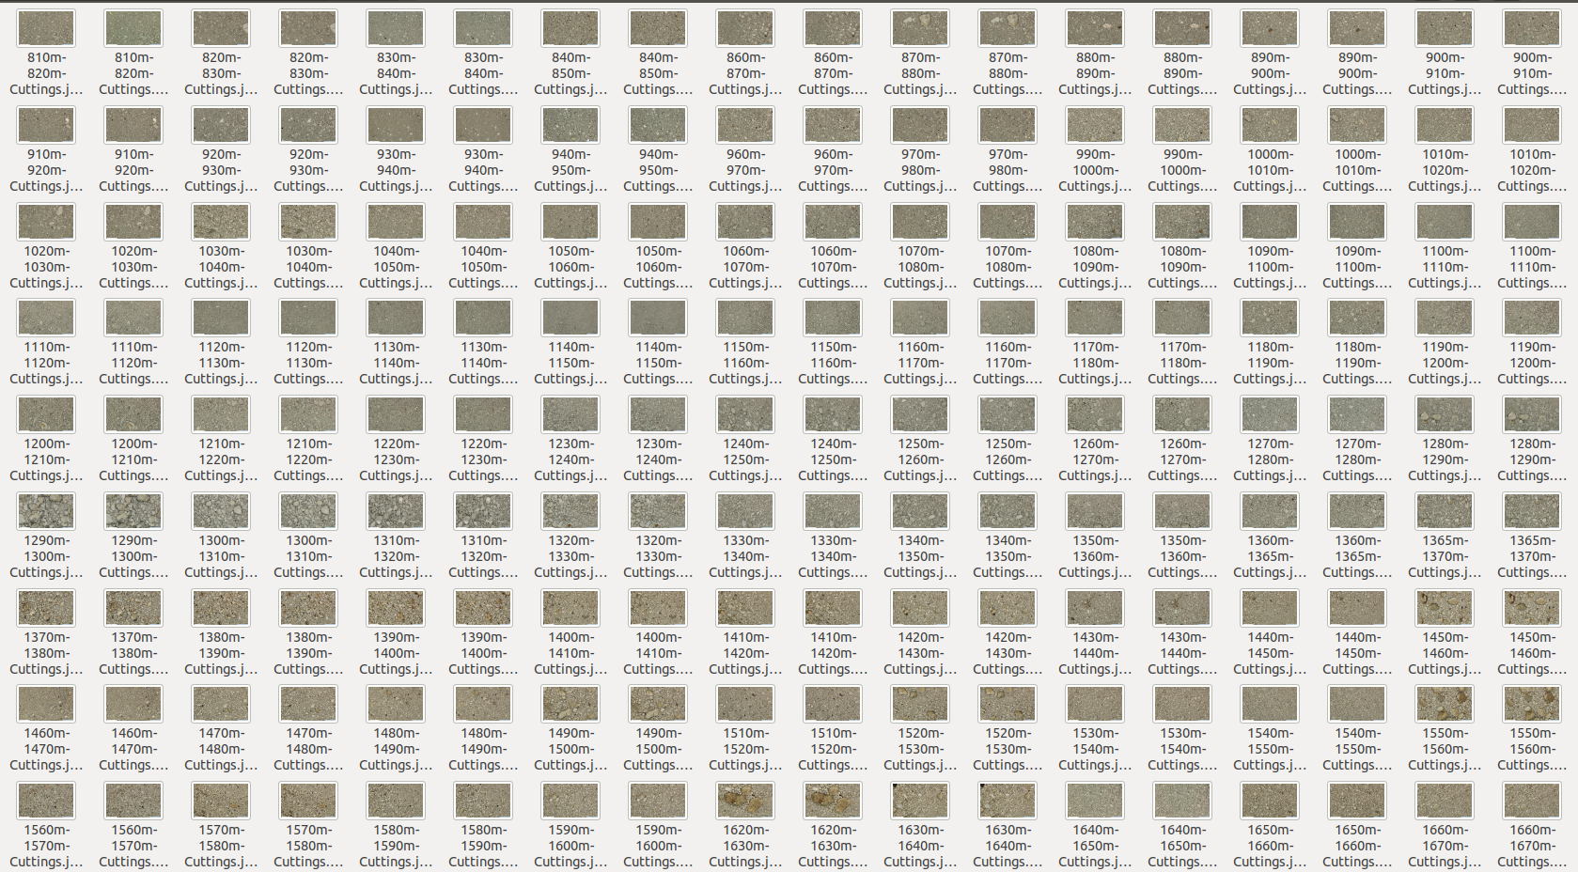
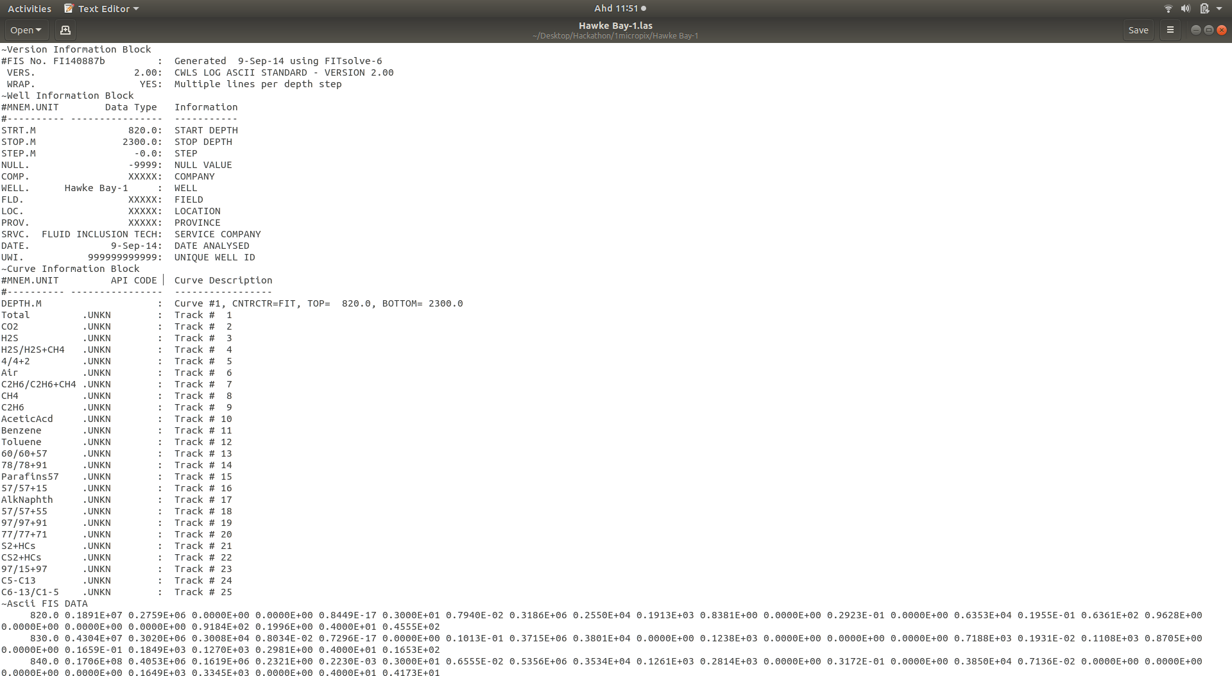
Initial data provided

Slide 3
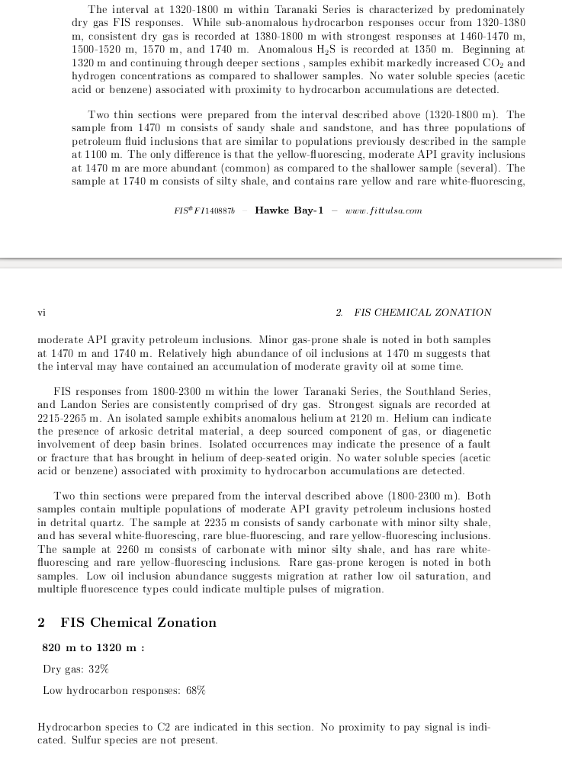
What ties it together

Slide 4
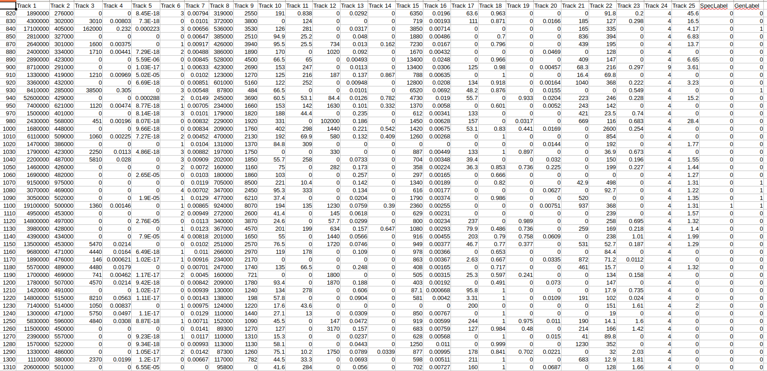
Annotate .las files

Slide 5
Classifier Results
 | SpecLabel | Raw | Generated | GenLabel | Raw | Generated
Nearest Neighbors |  | 0.2173913 | 0.031 |  | 0.2854 | 0.7255369
Gaussian Process |  | 0.5652173 | 0 |  | 0 | 0.6038186
Random Forest |  | 0 | 0.6408 |  | 0.4368 | 0.8591885
Neural Net |  | 0 | 0.4636 |  | 0.9328 | 0.6563245
AdaBoost |  | 0 | 0 |  | 1 | 0.9713603
Naive Bayes |  | 0.0869565 | 1 |  | 1 | 0.1145584
QDA |  | 0 | 0 |  | 0.8252 | 0.1384248

Slide 6
Cross validation
k_range = list(range(1, 31))
weight_options = ['uniform', 'distance']
param_grid = dict(n_neighbors=k_range, weights=weight_options)
rfc = RandomForestClassifier(n_jobs=-1,max_features= 'sqrt' ,n_estimators=50, oob_score = True)
param_grid = {
'max_depth' : [5,15,25,35,45,55,65,75,85,95],
'n_estimators': [100,200, 300,400,500,600,700,800,900,1000],
'max_features': ['auto', 'sqrt', 'log2']
}
ABC = AdaBoostClassifier()
param_grid = {"n_estimators": [10,20,30,40,50,60,70,80,90,100],"learning_rate":[0.001,0.01,0.1,1]}
grid = GridSearchCV(ABC, param_grid=param_grid, scoring = 'roc_auc')

Slide 7
CV Results
{'n_neighbors': 3, 'weights': 'uniform'}
{'max_depth': 25, 'max_features': 'sqrt', 'n_estimators': 900}
{'learning_rate': 0.1, 'n_estimators': 90}

Slide 8
Web App Demo Pipeline
Sample random rows of data from .las file
Infer sampled data on availability of inclusion
Display results, confusion matrix and classification report
Have a look at our web app : 13.67.66.80:5000/nlp
Github link : github.com/twistcode/Micropix-Twissie-Twistcode

Slide 9
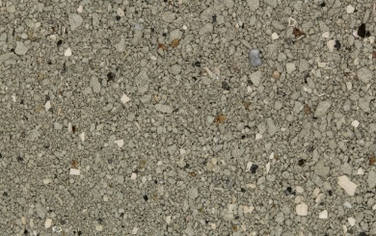
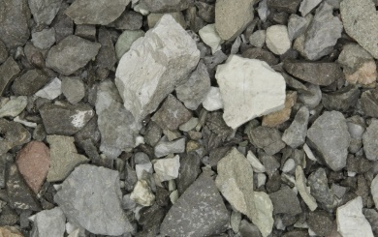


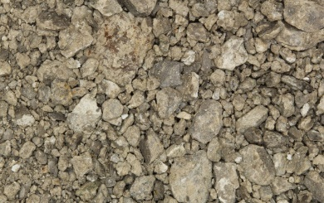
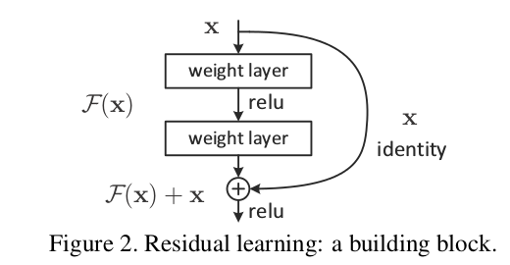
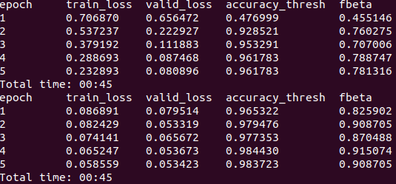
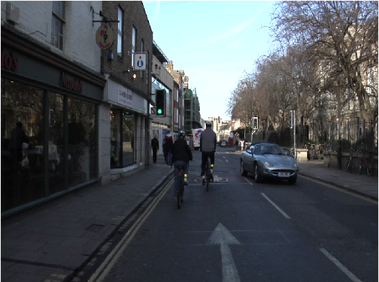
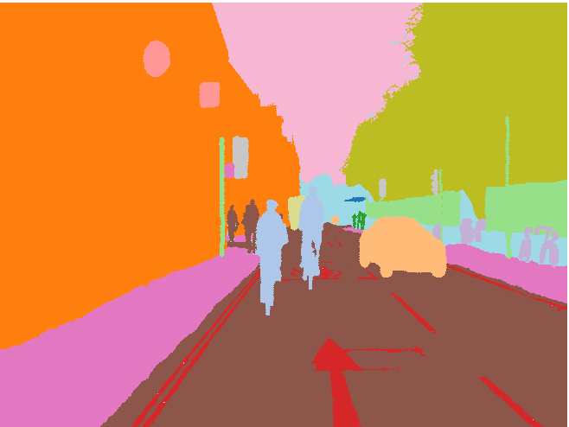
Extracting rock properties using core images
Contact email : hasif@twistcode.com
Problem : Getting the rock properties using core images only are literally super hard! One would need to do an extra work to get more information right?
Let’s train our neural network!
Inferencing ☺
Things to keep in mind :
1 - Cropping, resizing the ori image down to (642, 558)
2 - Input image during training (362, 362)
3 - Progressive resizing (Leslie, 2018) to (400, 400)
4 – Within less than 2 mins.. (Save the model)
5. Train loss > valid loss & accuracy > 90 (Good to go!)
3 different location, depth and properties of rock
RESNET34
Our future work – Rock Segmentation
Unfreeze Freeze
Image A
Hawkey
Depth 800m - 1600m
Check rock properties
Image B
Westcape
Depth 800m - 1900m
Check rock properties
Have a look at our web app : 13.67.66.80:5000
Github link : github.com/twistcode/Micropix-Twissie-Twistcode

Slide 10

FIS Chemical Zonation Summary
From the report in the datasets given..
Hawkey-Bay (820m to 1320m)
Waimamaku (1600m to 3356m)
Westcape (2900m to 3680m)
Dry gas = 32 %
Low hydrocarbon response = 68 %
Hydrocarbon species to C2 are indicated. No proximity to pay signal is indicated. Sulfur species are not present.
Dry gas = 27 %, Wet gas = 0 %
Low hydrocarbon response = 73 %
Hydrocarbon species to C7 are indicated. Proximity to gas indications are rare. No proximity to liquid petroleum.
Dry gas = 9 %
Low hydrocarbon response = 91 %
Hydrocarbon species to C1 are observed. No proximity signal is present. Sulphur species are not recorded.
Hawkey-Bay (1320m to 1800m)
Tawatawa (760m to 1155m)
Dry gas = 42 %
Low hydrocarbon response = 58 %
Hydrocarbon species to C4 are preserved. No proximity to pay signal is present. Sulfur species are not present.
Low hydrocarbon response = 100 %
Hydrocarbon species to C1 are documented. No proximity to pay signal is present. Sulphur species are documented.
We really forget about the HOKI ☹
Hawkey-Bay (1800m to 2300m)
Tawatawa (1160m to 1570m)
Dry gas = 79 %
Low hydrocarbon response = 21 %
Hydrocarbon species to C4 are found. No proximity to pay signal is present. Sulfur species are not observed.
Dry gas = 6 %
Low hydrocarbon response = 94 %
Hydrocarbon species to C1 are preserved. No proximity to pay signal is found. Sulphur species are found.
Waimamaku (152m to 1600m)
Westcape (1510m to 2900m)
Dry gas = 5 %, Wet gas = 16 %
Low hydrocarbon response = 79 %
Hydrocarbon species to C6 are present. No proximity to pay signal is preserved. Sulfur species are rarely recorded.
Low hydrocarbon response = 100 %
No proximity to pay signal is documented. Sulphur species are not found.

